Slide 1
RATHINAM
CENTRE OF EXCELLENCE
Database Management System
Database Normalization
by
Mrs.B.Sharmila
Technical trainer

Slide 2
Normalization
Contents:
Problems without Normalization
How Normalization solve these problems
Types Of Normal Forms

Slide 3
Introduction to Normalization
What is Normalization?
Normalization is a technique of organizing the data into multiple related tables , to minimize DATA REDUNDANCY.

Slide 4
Data Redundancy
What is DATA REDUNDANCY?
Why we have to reduce it?

Slide 5
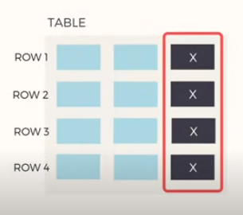
Data Redundancy
Repetition of data increases the size of database.
Other issues like:
Insertion Problems
Deletion Problems
Updation Problems.

Slide 6
Example of Data Redundancy
Student Table
RollNo | Name | Branch | HOD | Office_tel
1 | AAA | CSE | X | 12345
2 | BBB | CSE | X | 12345
3 | CCC | CSE | X | 12345
4 | DDD | CSE | X | 12345
RollNo | Name | Branch | HOD | Office_tel
1 | AAA | CSE | X | 12345
2 | BBB | CSE | X | 12345
3 | CCC | CSE | X | 12345
4 | DDD | CSE | X | 12345
The entire information about the branch is repeated for all the records in the student table . This is called data redundancy.

Slide 7
Issues due to Data Redundancy
Unnecessary data repetition increases the size of the database.
And leads to more issues such as,
1.Insertion Anomaly
2.Deletion Anomaly
3.Updation Anomaly.

Slide 8
Insertion Anomaly
Now, In the students table if we need to insert few more students record.
Student Table
RollNo | Name | Branch | HOD | Office_tel
1 | AAA | CSE | X | 12345
2 | BBB | CSE | X | 12345
3 | CCC | CSE | X | 12345
4 | DDD | CSE | X | 12345
5 | EEE | CSE | X | 12345
RollNo | Name | Branch | HOD | Office_tel
1 | AAA | CSE | X | 12345
2 | BBB | CSE | X | 12345
3 | CCC | CSE | X | 12345
4 | DDD | CSE | X | 12345
5 | EEE | CSE | X | 12345
RollNo | Name | Branch | HOD | Office_tel
1 | AAA | CSE | X | 12345
2 | BBB | CSE | X | 12345
3 | CCC | CSE | X | 12345
4 | DDD | CSE | X | 12345
To insert redundant data for every new row is a DATA INSERTION PROBLEM or ANOMALY.

Slide 9
Reason for Insertion Anomaly
Two different but related data is stored in the table.
Student Table
RollNo | Name | Branch | HOD | Office_tel
1 | AAA | CSE | X | 12345
2 | BBB | CSE | X | 12345
3 | CCC | CSE | X | 12345
4 | DDD | CSE | X | 12345
5 | EEE | CSE | X | 12345

Slide 10
Deletion Anomaly
Now, If we start deleting student information from the table. The branch information is also get deleted simultaneously leading to the loss of branch data.
Student Table
RollNo | Name | Branch | HOD | Office_tel
1 | AAA | CSE | X | 12345
RollNo | Name | Branch | HOD | Office_tel
1 | AAA | CSE | X | 12345
2 | BBB | CSE | X | 12345
RollNo | Name | Branch | HOD | Office_tel
1 | AAA | CSE | X | 12345
2 | BBB | CSE | X | 12345
3 | CCC | CSE | X | 12345
4 | DDD | CSE | X | 12345
RollNo | Name | Branch | HOD | Office_tel
1 | AAA | CSE | X | 12345
2 | BBB | CSE | X | 12345
3 | CCC | CSE | X | 12345
We have not stored branch information.
Loss of related dataset when some other data is deleted is called DATA DELETION PROBLEM or ANOMALY.

Slide 11
Updation Anomaly
Now ,let’s say HOD X leaves and Y joined as a new HOD.
Student Table
RollNo | Name | Branch | HOD | Office_tel
1 | AAA | CSE | X Y | 12345
2 | BBB | CSE | X Y | 12345
3 | CCC | CSE | X Y | 12345
4 | DDD | CSE | X Y | 12345
While updating the data, if you missed to update a record then that will leads to inconsistent of data.
Data Redundancy can also leads to inconsistent of data as a result of updation Anomaly.

Slide 12
Normalization
How Normalization solves this problems?

Slide 13
Normalization
RollNo | Name | Branch | HOD | Office_tel
OLD STUDENT TABLE
RollNo | Name | Branch
NEW STUDENT TABLE
Branch | HOD | Office_tel
NEW BRANCH TABLE
Student Table = Student table + Branch Table

Slide 14
Normalization
Branch / Department Table
Student Table
Branch | HOD | Office_tel
CSE | Y | 12345
RollNo | Name | Branch
1 | AAA | CSE
2 | BBB | CSE
3 | CCC | CSE
4 | DDD | CSE
Normalization is not eliminating the data redundancy.
Normalization is minimizing the data redundancy

Slide 15
Normalization
Less Redundancy fewer problems in data insertion, updation and deletion.
Student Table
Branch / Department Table
RollNo | Name | Branch
1 | AAA | CSE
2 | BBB | CSE
3 | CCC | CSE
4 | DDD | CSE
Branch | HOD | Office_tel
CSE | Y | 12345

Slide 16
Insertion Anomaly Solved- Normalization
Student Table
Branch / Department Table
RollNo | Name | Branch
1 | AAA | CSE
2 | BBB | CSE
3 | CCC | CSE
4 | DDD | CSE
RollNo | Name | Branch
1 | AAA | CSE
2 | BBB | CSE
3 | CCC | CSE
4 | DDD | CSE
5 | EEE | CSE
Branch | HOD | Office_tel
CSE | Y | 12345

Slide 17
Deletion Anomaly Solved- Normalization
Student Table
Branch / Department Table
RollNo | Name | Branch
1 | AAA | CSE
2 | BBB | CSE
3 | CCC | CSE
4 | DDD | CSE
Branch | HOD | Office_tel
CSE | Y | 12345
RollNo | Name | Branch
1 | AAA | CSE
2 | BBB | CSE
3 | CCC | CSE
4 | DDD | CSE
5 | EEE | CSE

Slide 18
Updation Anomaly Solved- Normalization
Student Table
Branch / Department Table
RollNo | Name | Branch
1 | AAA | CSE
2 | BBB | CSE
3 | CCC | CSE
4 | DDD | CSE
Branch | HOD | Office_tel
CSE | Y | 12345
Make Changes here.

Slide 19
Types Of Normalization
First Normal Form
Second Normal Form
Third Normal Form
BCNF (Boyce Cod Normal Form)
Fourth Normal Form
Fifth Normal Form.

Slide 20
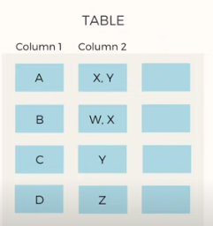
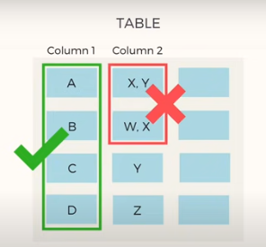
First Normal Form
Rule 1 for first normal form:
Each Column should contain atomic values.
Entries like X,Y and W,X violate this rule.

Slide 21
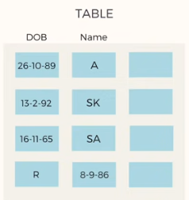
First Normal Form
Rule 2 for first normal form:
A Column should contain values that are of the same type.
Do not inter – mix different types of values in any column.

Slide 22
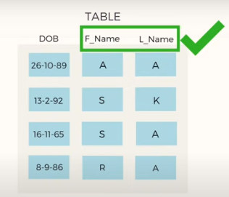
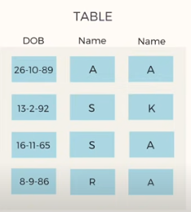
First Normal Form
Rule 3 for first normal form:
Each column should have a unique name.
Same names leads to confusion at the time of data retrieval.

Slide 23
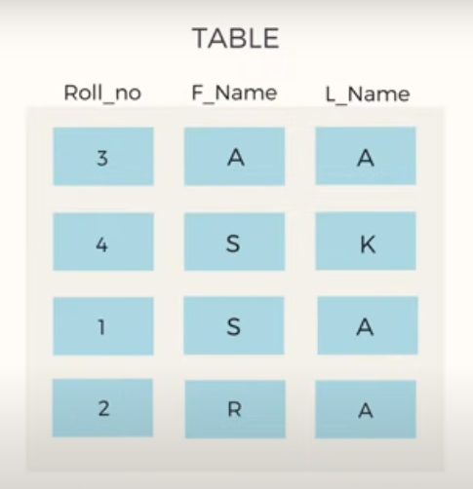
First Normal Form
Rule 4 for first normal form:
Order in which data is saved doesn’t matter.
Using SQL Query, you can easily fetch data in any order from a table.

Slide 24
Example of First Normal Form
Student Table
Roll_No | Name | Subject
101 | Akon | OS, CN
103 | Ckon | Java
102 | Bkon | C, C++
Violates Rule 1
How to solve this Problem?
It's very simple, because all we have to do is break the values into atomic values.
Roll_No | Name | Subject
101 | Akon | OS
101 | Akon | CN
103 | Ckon | Java
102 | Bkon | C
102 | Bkon | C++

Slide 25
Result Of First Normal Form
Using the First Normal Form, data redundancy increases, as there will be many columns with same data in multiple rows but each row as a whole will be unique.

Slide 26
Second Normal Form
For a table to be in the Second Normal Form, it must satisfy two conditions:
The table should be in the First Normal Form.
There should be no Partial Dependency.

Slide 27
Partial Dependency
What is Dependency?
Let's take an example of a Student table with columns student_id, name, reg_no(registration number), branch and address(student's home address).
student_id | name | reg_no | branch | address
10 | Akon | 07-WY | CSE | Kerala
11 | Akon | 08-WY | IT | Gujarat
In this table, student_id is the primary key and will be unique for every row, hence we can use student_id to fetch any row of data from this table.
This is Dependency and we also call it Functional Dependency.
Notes:
I can ask from branch name of student with student_id 10, and I can get it. Similarly, if I ask for name of student with student_id 10 or 11, I will get it. So all I need is student_id and every other column depends on it, or can be fetched using it.

Slide 28
Partial Dependency
Now, we have
Student Table
Subject Table
Score Table
To save marks obtained by students in each subject

Slide 29
Partial Dependency
Let's create another table for Subject (Subject_ID,Subject_Name)
Subject_ID | Subject_Name
1 | Java
2 | C++
3 | Php
Primary Key Subject_ID

Slide 30
Partial Dependency
Let's create another table Score, to store the marks obtained by students in the respective subjects.
Score(Score_id,Student_id,Subject_id,Marks,Staff)
Score_id | Student_id | Subject_id | Marks | Staff
1 | 10 | 1 | 70 | Java Teacher
2 | 10 | 2 | 75 | C++ Teacher
3 | 11 | 1 | 80 | Java Teacher
Notes:
Now that we know what dependency is, we are in a better state to understand what partial dependency is.
For a simple table like Student, a single column like student_id can uniquely identify all the records in a table.
But this is not true all the time. So now let's extend our example to see if more than 1 column together can act as a primary key.

Slide 31
Partial Dependency
What is the Primary Key of Score table?
Score_ID
Student_ID +Subject_ID

Slide 32
Partial Dependency
Score Table
Score_id | Student_id | Subject_id | Marks | Staff
1 | 10 | 1 | 70 | Java Teacher
2 | 10 | 2 | 75 | C++ Teacher
3 | 11 | 1 | 80 | Java Teacher
4 | 11 | 2 | 85 | C++ Teacher
Student_ID +Subject_ID

Slide 33
Partial Dependency
Where is the Partial Dependency?

Slide 34
Partial Dependency
Now if you look at the Score table, we have a column named Staff which is only dependent on the subject,
Score Table
Score_id | Student_id | Subject_id | Marks | Staff
1 | 10 | 1 | 70 | Java Teacher
2 | 10 | 2 | 75 | C++ Teacher
3 | 11 | 1 | 80 | Java Teacher
4 | 11 | 2 | 85 | C++ Teacher
Primary Key = Student_ID +Subject_ID
Notes:
Now as we just discussed that the primary key for this table is a composition of two columns which is student_id & subject_id but the teacher's name only depends on subject, hence the subject_id, and has nothing to do with student_id.

Slide 35
Partial Dependency
This is Partial Dependency, where an attribute in a table depends on only a part of the primary key and not on the whole key.
How to remove Partial Dependency?

Slide 36
Removing Partial Dependency
The solution is to remove columns Staff from Score table and add it to the Subject table. Hence, the Subject table will become:
Subject Table
Subject_ID | Subject_Name | Staff
1 | Java | Java Teacher
2 | C++ | C++ Teacher
3 | Php | Php Teacher

Slide 37
Second Normal Form
And our Score table is now in the second normal form, with no partial dependency.
Score Table
Score_id | Student_id | Subject_id | Marks
1 | 10 | 1 | 70
2 | 10 | 2 | 75
3 | 11 | 1 | 80
4 | 11 | 2 | 85

Slide 38
Quick Recap for second normal form
For a table to be in the Second Normal form, it should be in the First Normal form and it should not have Partial Dependency.
Partial Dependency exists, when for a composite primary key, any attribute in the table depends only on a part of the primary key and not on the complete primary key.
To remove Partial dependency, we can divide the table, remove the attribute which is causing partial dependency, and move it to some other table where it fits in well.

Slide 39
Third Normal Form
For a table to be in the Second Normal Form, it must satisfy two conditions:
The table should be in the Second Normal Form.
There should be no Transitive Dependency.

Slide 40
Third Normal Form
In the Score table, we need to store some more information such as exam name and total marks.
Score Table
Score_id | Student_id | Subject_id | Marks | ExamName | Tot_Marks
1 | 10 | 1 | 70
2 | 10 | 2 | 75
3 | 11 | 1 | 80
4 | 11 | 2 | 85
Primary Key = Student_ID +Subject_ID

Slide 41
Transitive Dependency
Does Column 1, Exam_Name depends on the primary key (StudentId +SubjectID)?
YES
Does Column 2, total_marks depends on the primary key (StudentId +SubjectID)?
NO
Total marks depends on exam name instead of the primary key.
Notes:
Total Marks for internal exam is different from Anna university.

Slide 42
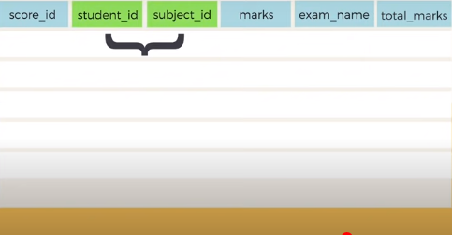
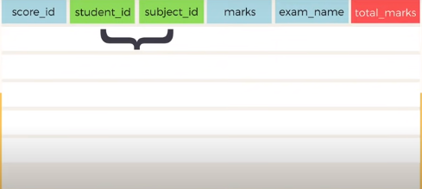
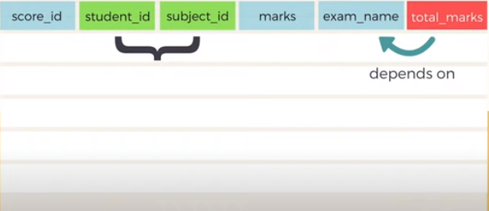
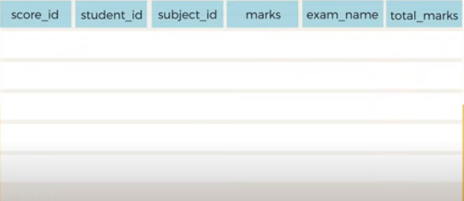
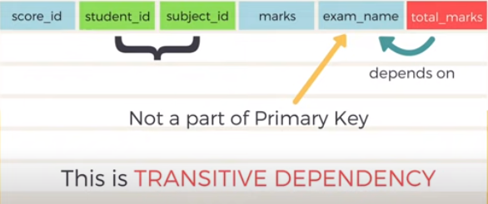
Transitive Dependency
Transitive Dependency is when a non-prime attribute depends on other non-prime attributes rather than depending upon the prime attributes or primary key.
Score Table

Slide 43
Removing Transitive Dependency
How to remove Transitive Dependency?
The solution is very simple. Remove the columns exam_name and total_marks from Score table and put them in an Exam table and use the exam_id wherever required.
Score Table
ExamTable
Score_id | Student_id | Subject_id | Marks | Exam_Id
1 | 10 | 1 | 70 | 1
2 | 10 | 2 | 75 | 2
3 | 11 | 1 | 55 | 3
4 | 11 | 2 | 57 | 3
Exam_Id | Exam_name | Total_Marks
1 | Workshop | 200
2 | Main | 70
3 | Practicals | 60

Slide 44
Advantages of Removing Transitive Dependency
The advantage of removing transitive dependency is,
Amount of data duplication is reduced.
Data integrity achieved.

Slide 45
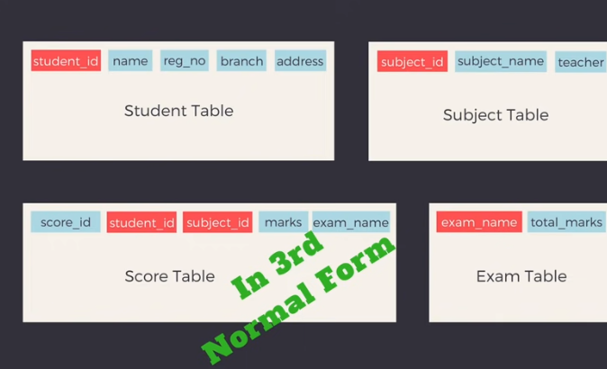
Third Normal Form

Slide 46
Boyce-Codd Normal Form
For a table to satisfy the Boyce-Codd Normal Form, it should satisfy the following two conditions:
It should be in the Third Normal Form.
And, for any dependency A → B, A should be a super key.
Notes:
The second point sounds a bit tricky, right? In simple words, it means, that for a dependency A → B, A cannot be a non-prime attribute, if B is a prime attribute.

Slide 47
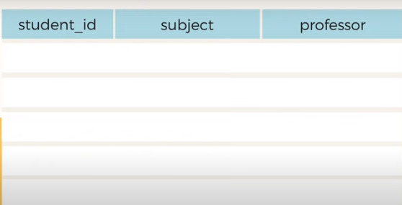
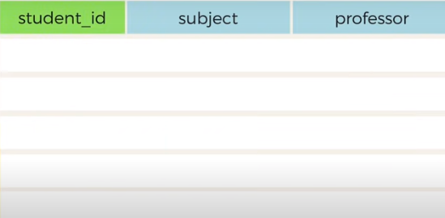
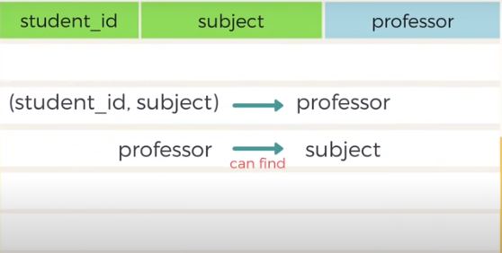
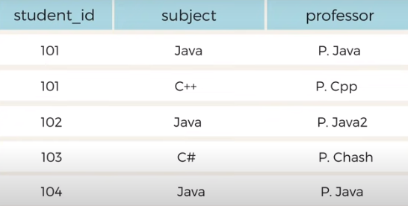
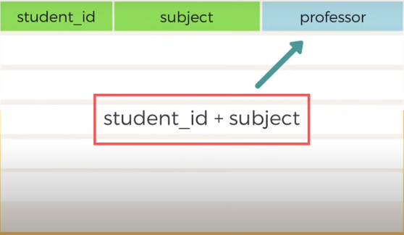
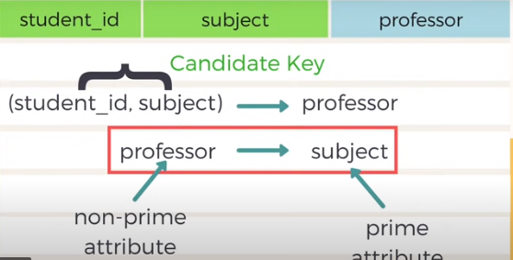
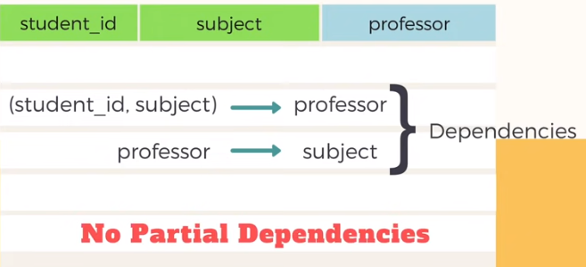
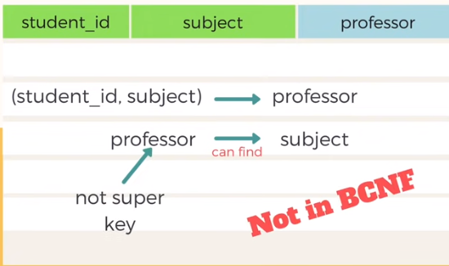
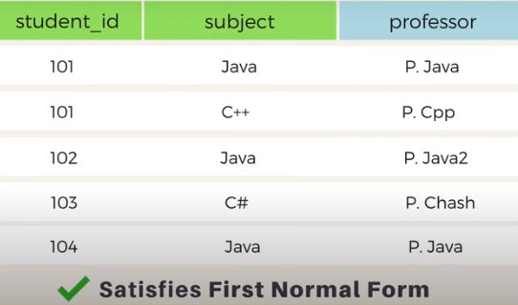
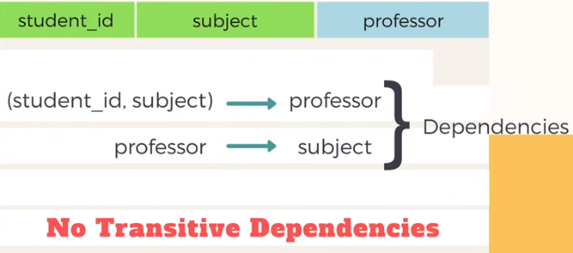
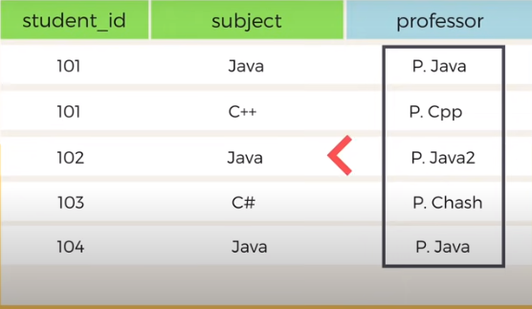
Boyce-Codd Normal Form
Consider a Couse Enrollment table,

Slide 48

Boyce-Codd Normal Form
How to make this table in BCNF?
Break the table

Slide 49
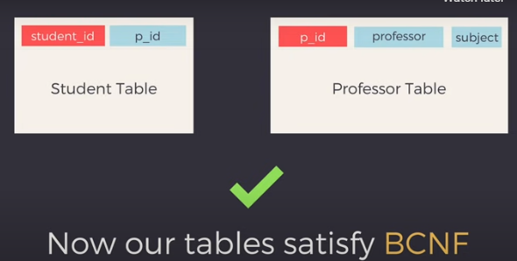
Boyce-Codd Normal Form

Slide 50
Fourth Normal Form
For a table to satisfy the Fourth Normal Form, it should satisfy the following two conditions:
It should be in the Boyce-Codd Normal Form.
And, the table should not have any Multi-valued Dependency.
Notes:
The second point sounds a bit tricky, right? In simple words, it means, that for a dependency A → B, A cannot be a non-prime attribute, if B is a prime attribute.

Slide 51
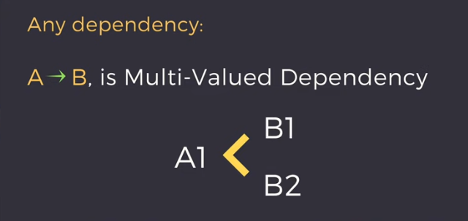
What Is multi-valued Dependency?

Slide 52
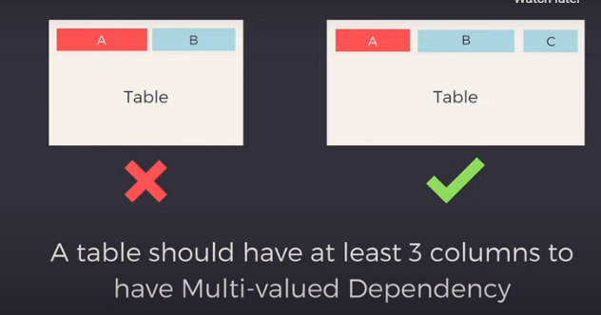
What Is multi-valued Dependency?

Slide 53
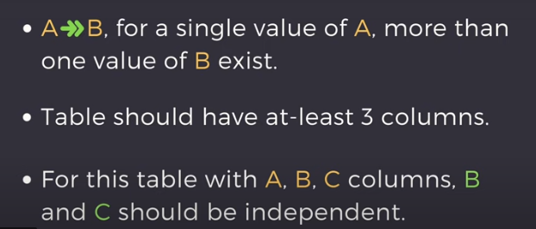
What Is multi-valued Dependency?

Slide 54
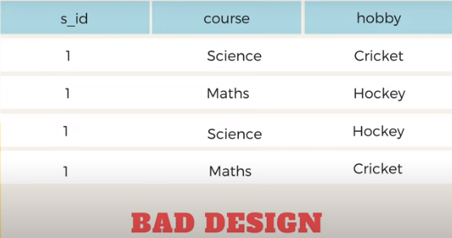
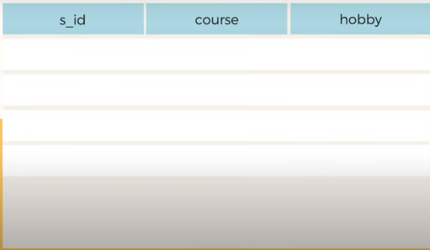
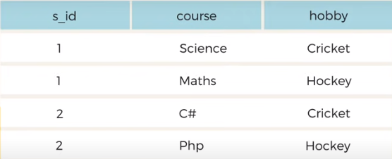
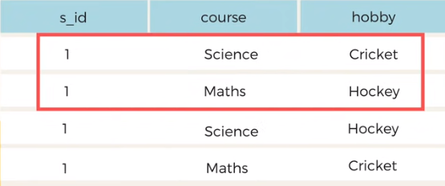
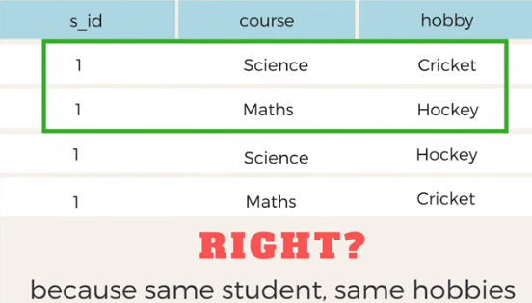
Example for Fourth Normal Form
No relationship Between columns.
Consider a Enrollment table,

Slide 55

Example for Fourth Normal Form
How to make this table in Fourth Normal Form?
Break the table

Slide 56
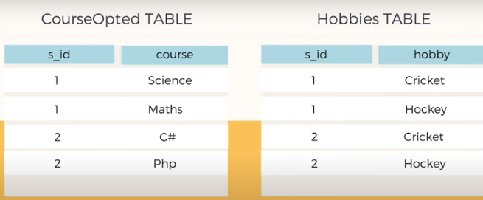
Example for Fourth Normal Form
Two Independent Tables in fourth normal form

Slide 57
Fifth Normal Form
For a table to satisfy the Fifth Normal Form, it should satisfy the following two conditions:
It should be in the Fourth Normal Form.
And, the table should not have Join Dependencies.
Note: Fifth Normal Form is also called as PJNF (Project Join Normal Form).

Slide 58
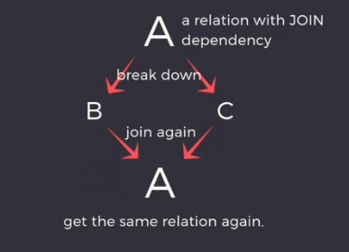
Fifth Normal Form
Join Dependency Principle:
If we decompose table further to eliminate redundancy and anomalies and when we rejoin the table we should not be losing the original data or get a new record.

Slide 59
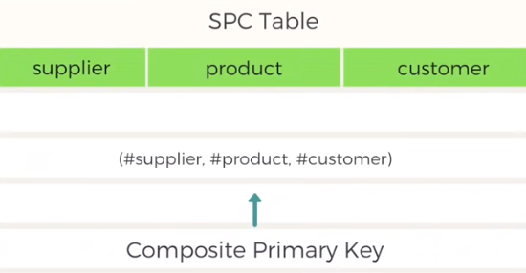
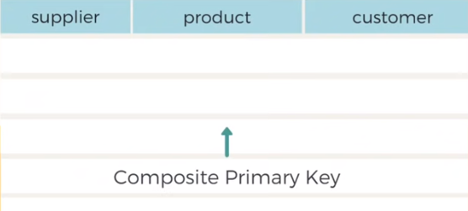
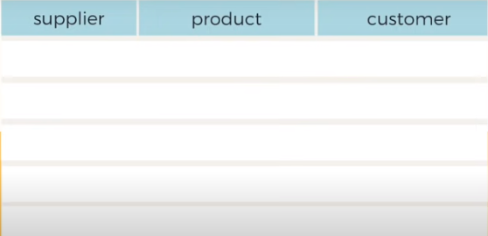
Example for Fifth Normal Form
Consider a Supplier_Product_Customer table,

Slide 60
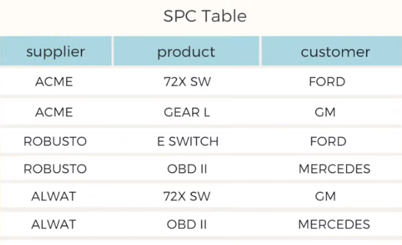
Fifth Normal Form
Lets add some data into the table
Is the table is in Fifth Normal Form?

Slide 61
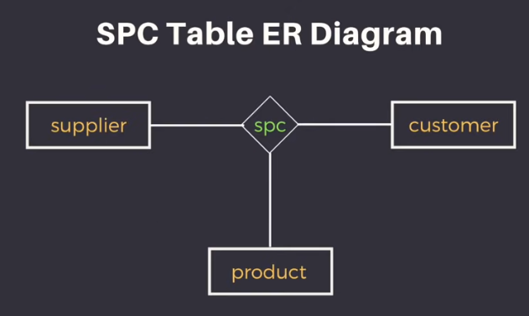
Fifth Normal Form
Lets create a ER diagram.
Ternary relationship as it involves 3 entities.

Slide 62
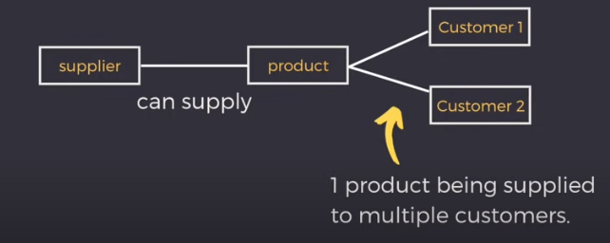
Fifth Normal Form
Notes:
A given supplier can supply a given product to any number of customers.

Slide 63
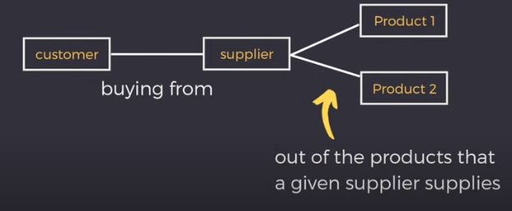
Fifth Normal Form
Notes:
A customer can buy any number of product from a supplier

Slide 64
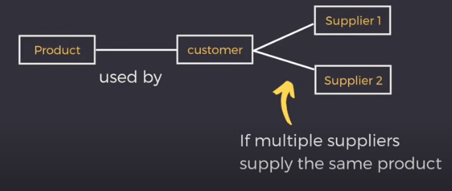
Fifth Normal Form
Notes:
A product used by a customer can be supplied by any number of supplier.

Slide 65
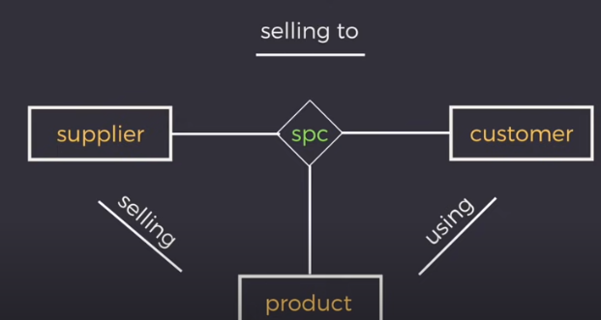
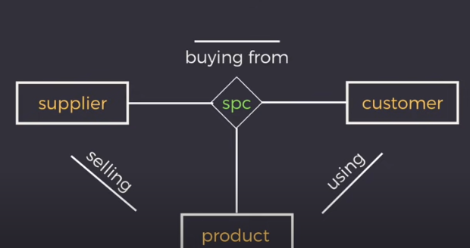
Fifth Normal Form

Slide 66
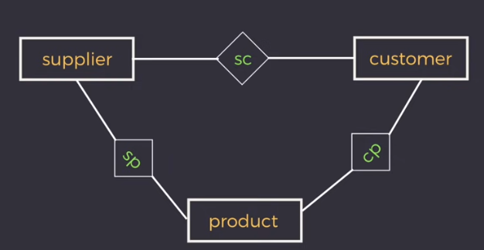
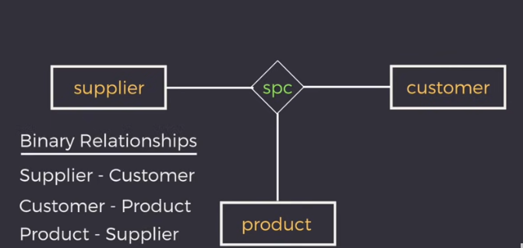
Fifth Normal Form

Slide 67
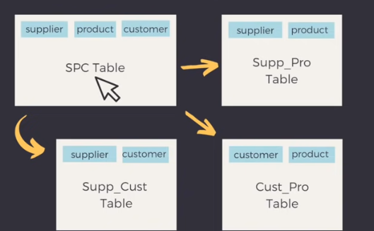
Fifth Normal Form
So , Our main table is divided into three sub tables.

Slide 68
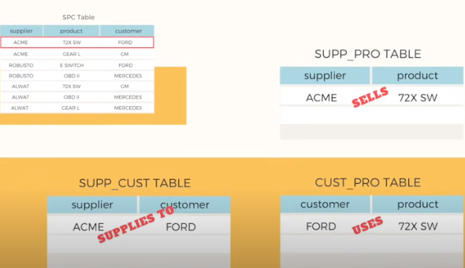
Fifth Normal Form
Now coming back to our original Data,

Slide 69
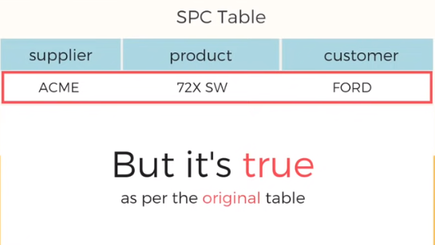

Fifth Normal Form

Slide 70



Fifth Normal Form
Ford might be getting the product 72X from some other supplier.

Slide 71


Fifth Normal Form
But as per the original table ACME sells 72X to Ford.

Slide 72

Fifth Normal Form

Slide 73
Fifth Normal Form
But if breaking down the table doesn’t lead to information loss then decompose the table.
when we combine the decomposed tables, the resultant table may not be equivalent to the original table, in that case the original table is said to be in 5NF provided it is already in 4NF.

Slide 74
Quiz
1. A functional dependency is a relationship between or among
A. Entities B. Rows C. Attributes D. Tables
2. Which functional dependency types is/are not present in the following dependencies? Empno -> EName, Salary, Deptno, DName DeptNo -> DName EmpNo -> DName
A. Full functional dependency B. Partial functional dependency C. Transitive functional dependency D. Both B and C
3. The database design prevents some data from being stored due to _______.
A. Deletion anomalies B. Insertion anomalies C. Update anomalies D. Selection anomalies

Slide 75
Quiz
4. If one attribute is determinant of second, which in turn is determinant of third, then the relation cannot be:
A. Well-structured B. 1NF C. 2NF D. 3NF
5. Which of the following statement(s) is/are FALSE about OLAP?
A. OLAP involves long running slow transactions that read lot of data B. OLAP involves frequent insert, update and delete operations C. OLAP requires data to be in De-Normalized form for optimal processing D. Both B and C
6. 5NF is designed to cope with :
A. Transitive dependency B. Join dependency C. Multi valued dependency D. None of these

Slide 76
Quiz
7. Consider the schema R(S,T,U,V) and the dependencies S→T, T→U, U→V, V→S. Let R= {R1,R2} such that R1∩R2=Φ. Then the decomposition is :
A. not in 2NF B. in 2NF but not in 3NF C. in 3NF but not in 2NF D. in both 2NF and 3NF
8. Third normal form is inadequate in situations where the relation :
A. has multiple candidate keys B. has candidate keys that are composite C. has overlapped candidate keys D. none of the above
9. Tables cannot have __________ on a Primary Key
A.2NF B.transitive dependencies C.join dependencies D.multi-valued dependencies E.none of these

Slide 77
Quiz
10. if the candidate key is determined then the table is in which foam.
A.2NF B.3NF C.BCNF D.4NF E.none of these

